Slide 1
MRes and Social Research Dissertation Workshop
Barry Maydom

Slide 2
Today’s Agenda
What is a dissertation?
Ethics
Working with your supervisor
Research topics and research questions
Concepts
Literature reviews
Research methods
Writing your dissertation
Assessment criteria

Slide 3
What is a Dissertation?
An original piece of research using a method or set of methods learned during your MSc/Mres
12000-15000 words
Supervised by an academic member of staff
Deadline: 15th September

Slide 4

Ethics

Slide 5

ESRC: Six Principles of Ethical Research
Research should be designed, reviewed and undertaken to ensure integrity and quality.
Research staff and subjects must be informed fully about the purpose, methods and intended possible uses of the research, what their participation in the research entails and what risks, if any, are involved.
The confidentiality of information supplied by research subjects and the anonymity of respondents must be respected.
Research participants must participate in a voluntary way, free from any coercion.
Harm to research participants must be avoided.
The independence of research must be clear, and any conflicts of interest or partiality must be explicit.

Slide 6
Costs and Benefits
There is never zero cost and risk to participants
Time costs
Seemingly innocuous survey or interview questions could trigger negative emotional responses
Bigger risks (eg reporting of illegal behaviours) require more careful consideration
Balance of costs and benefits
Risks should be mitigated as much as possible

Slide 7

Informed Consent
A description of the study should be provided to participants in advance, describing
the purpose of the research
the expected duration
what is involved
their right to decline to participate and to withdraw from the research once participation has begun
Participants must actively consent
Notes:
reasonably foreseeable factors that may be expected to influence their willingness to participate such as potential risks, discomfort, or adverse effects; any prospective research benefits; limits of confidentiality; incentives for participation; and whom to contact for questions about the research and research participants’ rights.
Deception is a situation in which subjects have essential information withheld and/or are intentionally misled about procedures and purposes. A thorough debriefing is particularly important in studies involving deception.

Slide 8

Privacy, Anonymity, Confidentiality
Personal information given by the subject should be confidential
Wherever possible, the researcher will take steps to ensure the anonymity of the subjects
Data Protection Act
Notes:
reasonably foreseeable factors that may be expected to influence their willingness to participate such as potential risks, discomfort, or adverse effects; any prospective research benefits; limits of confidentiality; incentives for participation; and whom to contact for questions about the research and research participants’ rights.
Deception is a situation in which subjects have essential information withheld and/or are intentionally misled about procedures and purposes. A thorough debriefing is particularly important in studies involving deception.

Slide 9


Vulnerable groups
Special care must be taken with vulnerable groups to ensure ethical treatment (e.g. children, prisoners, people with mental health issues)

Slide 10
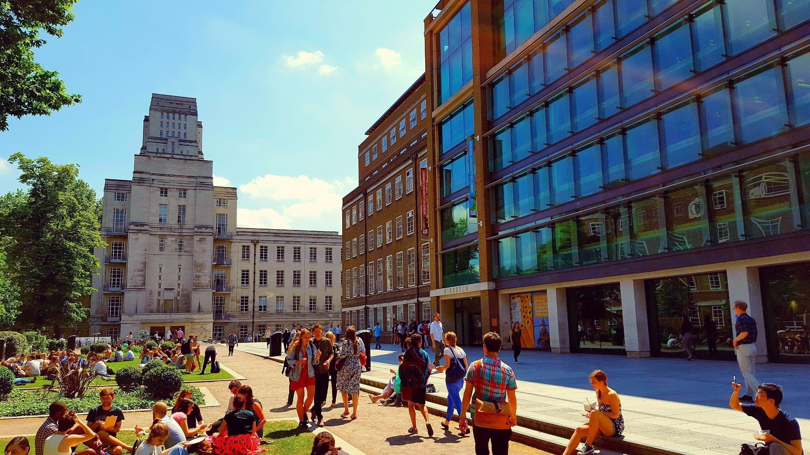
Ethics at Birkbeck
Students’ projects need to be reviewed by the supervisor to decide if they involve routine or non-routine research
Non-routine research
Participants’ physical or mental wellbeing is put at risk
Vulnerable populations are involved
Permission of a gatekeeper is required to access participants
Use of deception or lack of informed consent
Predictable media interest or sensitivity
Conflicts of interest

Slide 11
Ethics at Birkbeck
New procedure this year: details are available on Moodle
Draft ethics application online and send it to your supervisor
Your supervisor will advise you about next steps

Slide 12
Supervisors
Supervisors offer guidance and support, but not direction
They can advise you on research questions, approach, the outline structure and research design
They cannot comment on full drafts
3x1hr meetings (or more meetings for a shorter time)
It is your responsibility to arrange meetings
Agree a rough plan and schedule with your supervisor

Slide 13
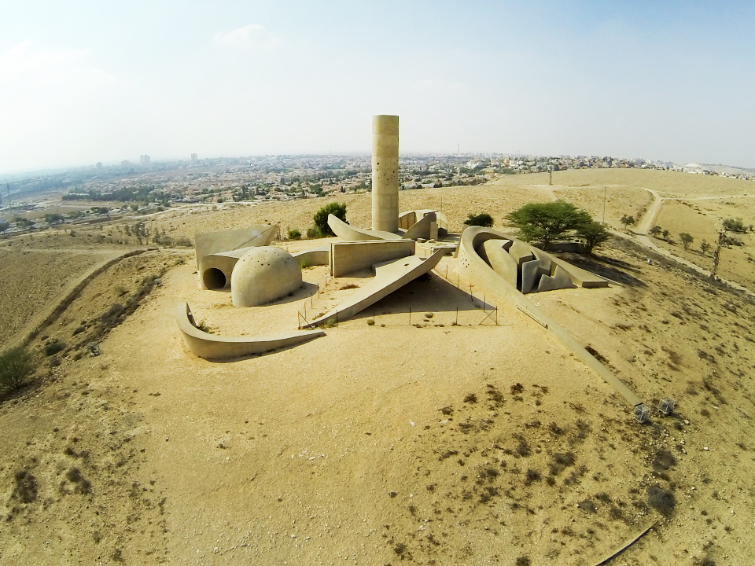



Some Examples

Slide 14

Research Topics and Research Questions
Research Topic
The overall field in which you are researching
If you are focussing on a particular event, movement, idea etc, consider what it is a case of
Research Question
Make sure you have a question that you can clearly express
Your dissertation should focus throughout on answering the question

Slide 15
Research Questions: Examples
Why has membership of the Labour Party increased substantially in recent years after years of decline?
Why do some left-wing militant groups turn to urban terrorism when significant pressure is applied, while others do not?
How does public sculpture contribute to the construction of nationalism in Israel?
How has the experience of political power changed how democracy is discussed by the AKP in Turkey?

Slide 16
Concepts
It is important to identify the key concepts in your research topic/question
Make sure you understand existing conceptual debates
Be clear about how you use the concepts in your argument
Don’t be afraid to criticise how concepts are used in the current literature
Think about operationalisation: how do you turn an abstract concept into something we can measure?

Slide 17
Key concepts: Examples
Party membership, populism
Terrorism
Nationalism
Democracy

Slide 18
Discussion
What are the key concepts in your research design?
How will you operationalize your concepts?

Slide 19

Literature Reviews
What research has already been done on your topic?
What are the key theories and debates?
What is missing from the existing literature and how will your dissertation contribute?
How to find relevant literature
Reading lists for modules you have taken
Libraries: Birkbeck and Senate House
Google Scholar
Look at the literature reviews of recent articles on your topic

Slide 20
Literature reviews: Examples
Cartel Party Thesis, quantitative studies
Instrumental theories of terrorism, studies of other terrorist groups
Ethno-symbolist approaches to nationalism, studies of nationalism in Israel
Political theory debates on conceptualising democracy, studies of elite discourse on democracy in other countries/regions

Slide 21
Discussion
What are the key theories you need to engage with?
What other studies have been done which might be relevant for your research?

Slide 22
Research Methods
You can use any method, or mix of methods, you think will help to answer the question
Qualitative: interviews, focus groups, case studies
Quantitative: surveys (original or existing), analysis of administrative data
Mixed methods: think carefully about how to combine them

Slide 23
Research Methods: Examples
Focus groups and a survey
Case studies based on news reports and published writings by militant leaders
Case studies based on news reports and art history books
Discourse analysis of President Erdogan’s speeches and analysis of World Values Survey data

Slide 24
Discussion
Which method(s) will you use in your project?
What data will you collect?

Slide 25

Writing Your Dissertation
Introduction
Literature Review
Theory
Methods
Results
Analysis/Discussion
Conclusion

Slide 26
Assessment Guidelines
the research question is well-defined, and contextualised
an argument is specified, coherently presented and supported by evidence
alternative arguments are analysed
the approach is critical, not descriptive
a relevant methodology is employed
relevant sources have been consulted
knowledge of relevant literature, issues and debates is demonstrated
the style and presentation is clear and careful, and appropriate academic conventions have been observed

Slide 27

Any Questions?

